Slide 2
Architecture Considerations
1. Architecture Style & Design Principles
Adopt Microservices Architecture aligned to business capabilities (Ideation, Campaign, WBS, Closure, etc.)
10. Experience Layer Considerations
Provide role-based dashboards (Controller, PMO, Admin, etc.)
Support search, filters
5. Integration Architecture
Follow API + Event + Batch hybrid integration model
Use Integration Adapter Layer (anti-corruption layer) for external systems (JIRA, SAP, etc.)
4. Security & Compliance
Implement Zero Trust Security Model, Use OAuth2 / JWT-based authentication (Azure AD integration), Ensure data encryption:
In transit (TLS), At rest (AES-256)
Support secure webhook validation for JIRA data consumptions
9. AI / GenAI & Agentic Capabilities
Introduce AI Orchestrator layer for AI-driven workflows
Use GenAI (MSIL standerdized LLMs) for: Summarization ,Insights generatio, Natural language querying
Implement AI Agents for Automated analysis (ie. Project risks, Delays), Decision support, Recommendations
Use vector database (MSIL standardized) for semantic search (optional)
Ensure guardrails, prompt security, and auditability
6. Data & Storage Strategy
Separation of System of Record (RDBMS) ,Operational / Read DB ,Archive / Cold Storage
3. High Availability & Resilience
Ensure no single point of failure with resilience pattern Circuit Breaker, Retry with backoff, Timeout handling ,Bulkhead isolation
7. Workflow, Rules & Orchestration
Use Workflow Engine / Orchestrator for long-running processes
Use Rule Engine for configurable business rules
2. Scalability & Performance
Support horizontal scaling via Kubernetes for stateless services, Caching, CQRS pattern
8. Observability & Operations
Implement application logs, infra metrics, business metrics,Alerting
Integrate with Incident Management tools

Slide 3





EPMP Architecture
Users
Transactional Users
External Users
*
Critical Controllers
Operational Orchestrators
Specialized Owners
User Engagement
External Users
EPMP Mobile App
EPMP Web Portal
External Systems
DMZ
MSIL Common Services
CONTENT DELIVERY NETWORK
Authentication
Rev Proxy , LB Layer
JWT
Jenkins
API Gateway
Authentication
Authorization
Server- MSIL Azure AD
JIRA
Rules
Policy
Rate Limit
Zendesk
Request with JWT
JWT
MZ
Caching
Session
Web BFF
Mobile BFF
Incident Management tool
SAP Success factor
Request with JWT
Integration Microservices
Biz Microservices
Journey Orchestrator
AI Orchestrator
Raise Incidents
Ideation
Campaign
Campaign Create Workflow
Collect app logs & Server Metrics.
Rule Configuration
Project Initiate
WBS Creation Workflow
Monitoring & Automation
Rule Engine
WBS
Demand
Ideation Create Workflow
Closure Workflow
Operational Orchestrators
Innovation
Closure
…
AI Agents
…
Deploy Application Package
DevOps
Reports & Dashboards
Document Repository
Istio
Log Agent
Log Agent
Istio
Critical Controllers
Backup
Backup File system and DB
Search Service
Event Messaging Platform
GenAI Platform
Enterprise Data Lake
Primary
Replica
Read
Replica
NoSQL
(Logs)
LLM
Monitor Endpoint security, Remote access, Vulnerability patch & Health check scans
Security
RDBMS
*Indicative Personas reference are Mentioned in the later slide

Slide 4
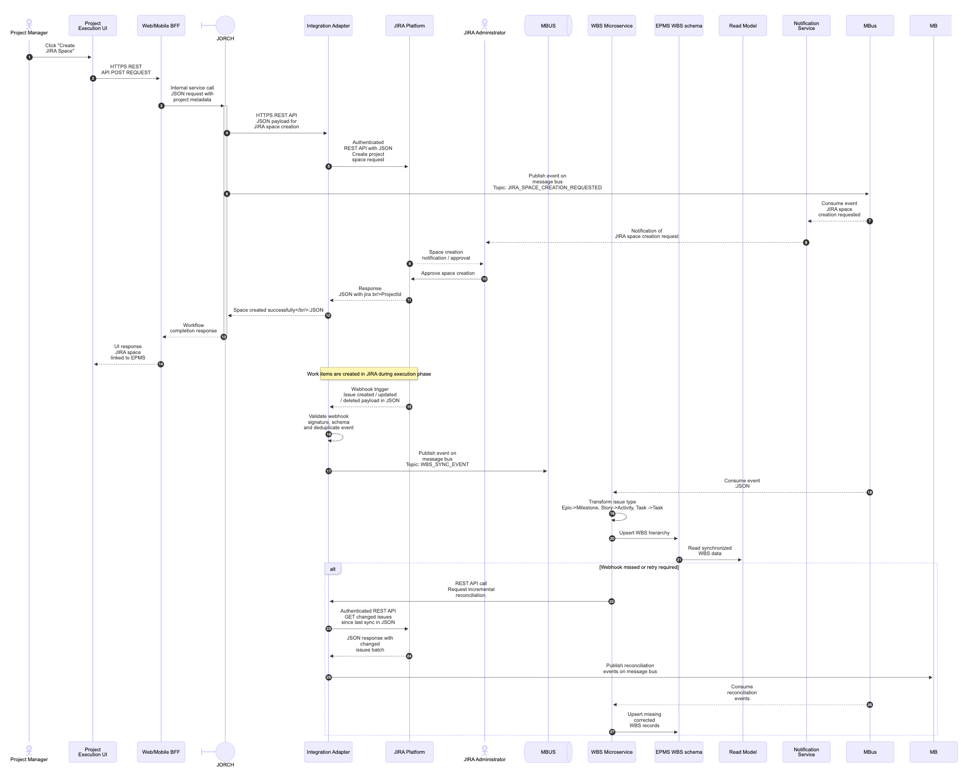
WBS Item With JIRA Integration Blueprint

Slide 5
Integration Architecture
SaaS
MSIL
DX Team
OpenText
IServ
Entra ID
Pull/REST API /Https
Push/Pull REST API /Https
Pull / REST API /Https
REST API/Https
EPMP Core
Integration
Adapter
EPMP BFF Services
REST API /Https
API Gateway
REST API
/Https
EPMP UI
SAP HRMS
Pull/REST API /Https
Pull/Batch
MSIL Users
EPMP Orchestrator Services
EPMP
AI Services
REST API/Https
LLM
Zendesk
Pull/REST API /Https
EPMP Buz Services
EPMP Data -Primary
MSIL Data Ingestion Qlik
JIRA
Webhook/Push/
REST API /Https
Push/CDC
Push
Keys (ClientID/Secret)/
JIRA CloudID
MSIL Data Lake
Published JIRA Events
Business Events
Consumer for JIRA Events
App Dynamics
Key/Secret Management
Message Broker
Search Service
MSIL Data Access Layer
Pull
Power BI
Report
Topics
MSIL Users
Pull Events Consumer

Slide 6
Gen AI Architecture
AI Orchestrator
Prompt Management
Model Routing
AI Guardrails
AI Agents ( Persona Agent Layer)
Project Manager Agent
Evaluator Agent
Program Governance Agent
SAP HRMS
Integration Services
Orchestrator Services
AI Platform Layer
Zendesk
LLM Model ( Bedrock/OpenAI/
RAG Layer (Vector DB + Knowledge Base)
AI Guardrails ( PII Guardrails, Prompt Injection, Validation
Prompt Registry
JIRA
EPMP Biz Micro services
Ideation
Planning
Execution
Demand
Initiation
WBS
Document Storage
EPMP Data -Primary
Vector Data base

